Slide 1
PHYSICAL FACILITIES
S. No. | Name of the Teaching – Learning Facility | No. Available
1 | Classrooms | 19
2 | Seminar Hall | 1
 | Mini Seminar Hall | 2
3 | ICT Enabled Classrooms | 15
4 | Laboratories Physics Laboratory Chemistry Laboratory Bio-Technology Laboratory Computer Laboratory | 01 01 01 02
5 | Library and Digital Library | 01
6 | Department Library | 04

Slide 2
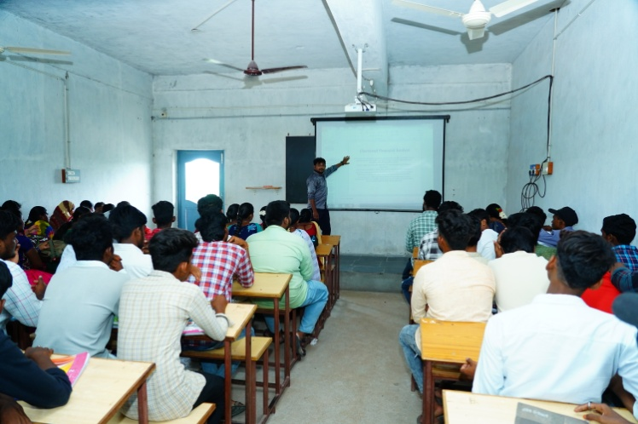
ICT Enabled Classrooms

Slide 3
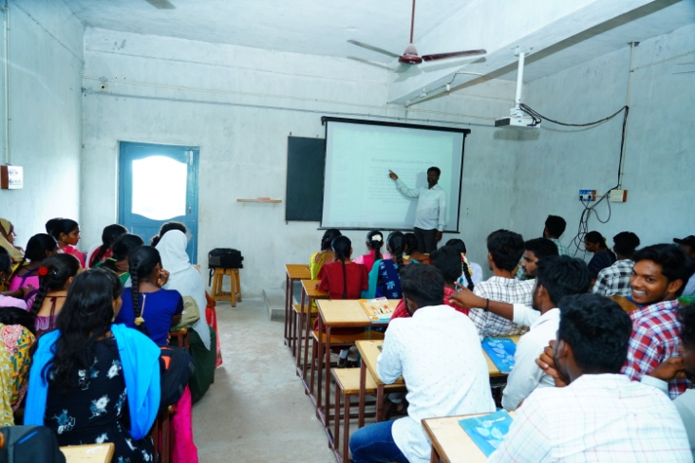

Slide 4
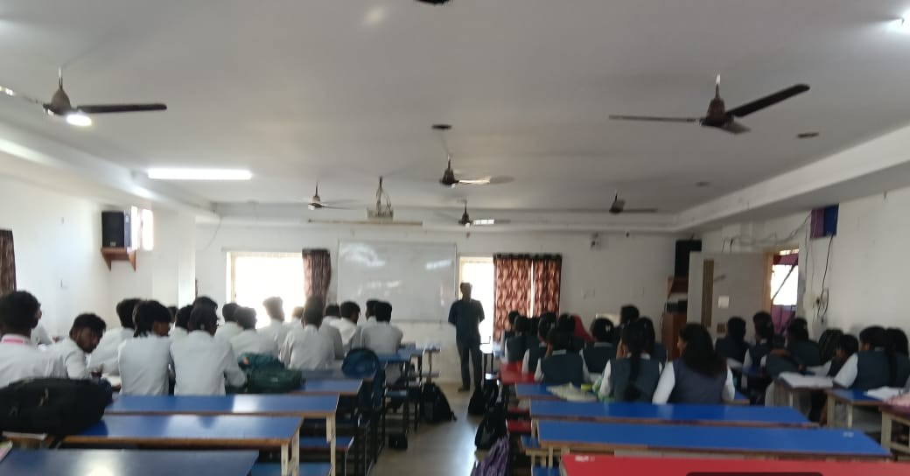
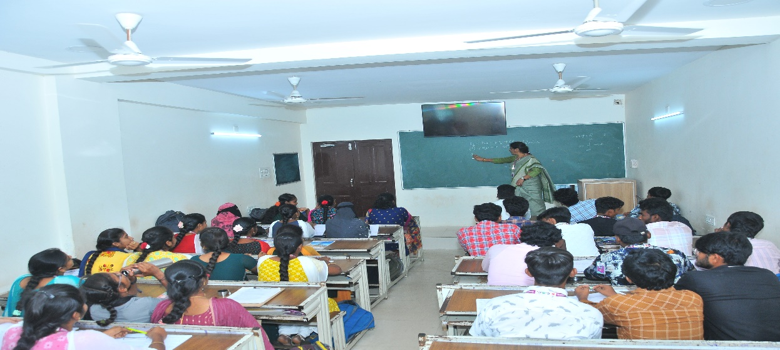
PHYSICAL FACILITIES – SEMINAR HALLS
Seminar Hall
Mini Seminar Hall-1

